Slide 1


Determine Trend In Hospital Component Wastage and Issues
Victor Omoboye
Data Analyst | Data Scientist
Caring | Expertise | Quality

Slide 2
Introduction
Key Insights
Conclusion
Q & A
Appendix
Methodology
Recommendation
Table of
Contents
Caring | Expertise | Quality

Slide 3

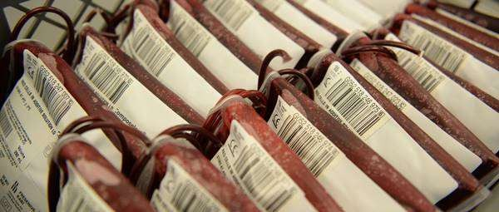
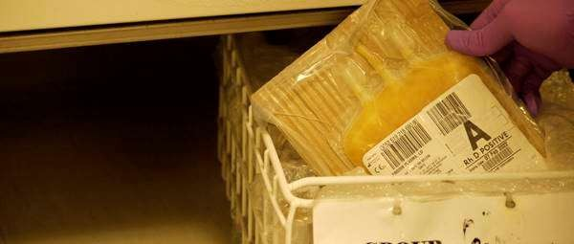
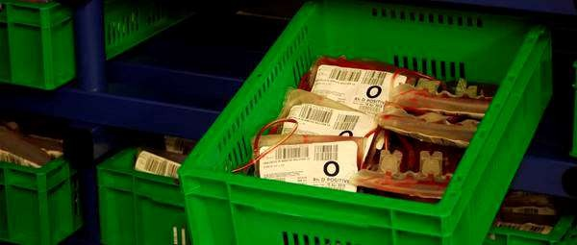
Introduction
The NHS Blood Stocks Management Scheme (BSMS) focuses on improving blood inventory management across the blood supply chain.
Data analyzed includes component issues and wastage for RBC, Platelets, and Frozen Plasma.
Objective: To identify trends and correlations to optimize inventory management and reduce wastage.

Slide 4
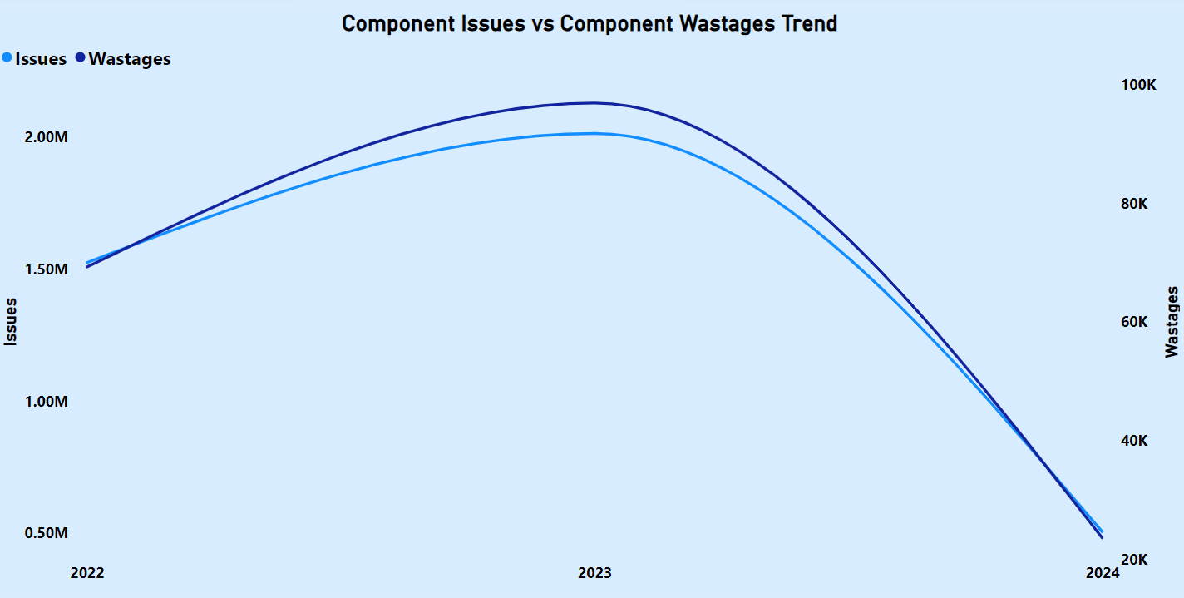
Key Insights
Yearly trend reveal a strong positive correlation between component issues and wastage, where higher issues correspond to increased wastage.
2023 recorded the highest levels of both issues and wastage.

Slide 5
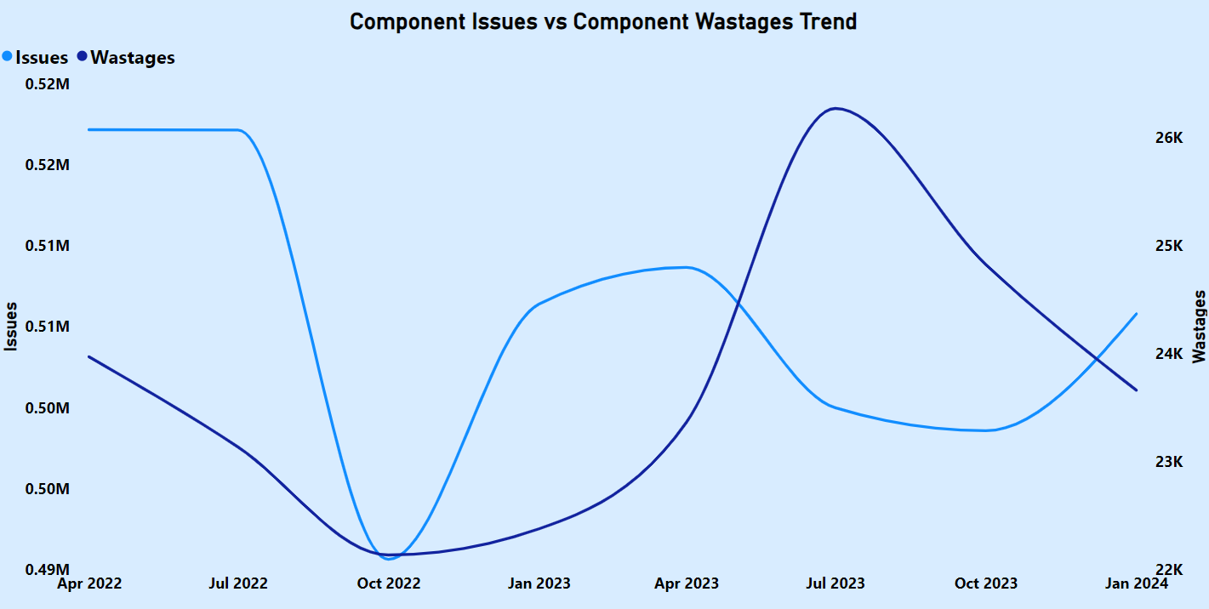
Key Insights
Seasonal and quarterly trends revealed significant fluctuations in issues and wastage.

Slide 6
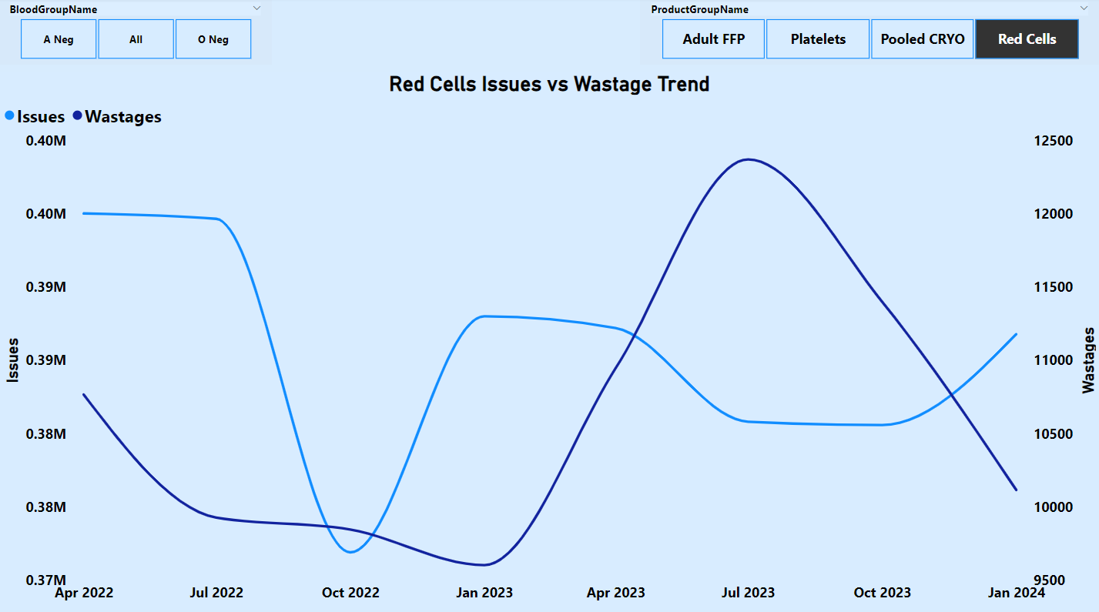
Key Insights
Red Cells Issues declined in Q3 2022 before surging in Q4 2022, While Wastage peaked between Q1 and Q2 2023 as issues experienced a slight decline in Q2.

Slide 7
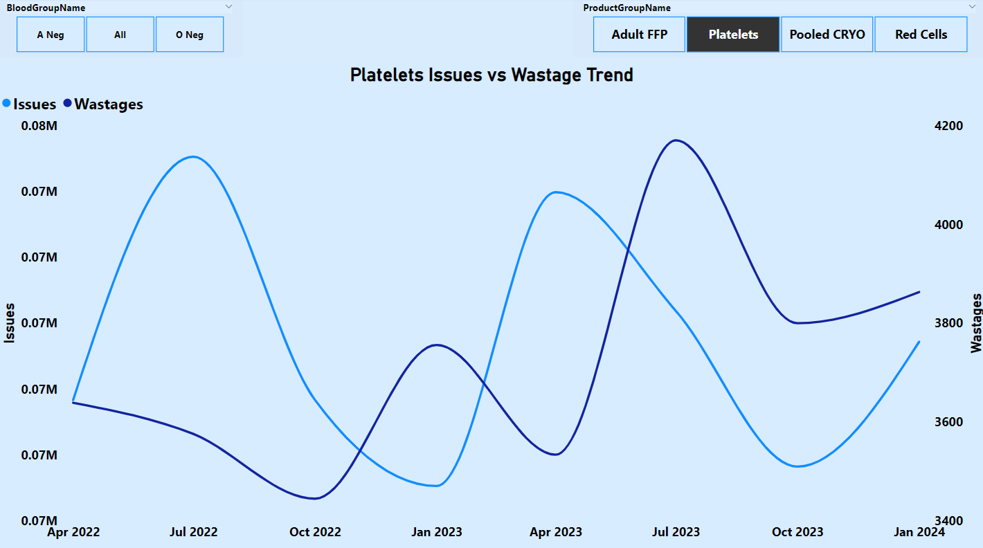
Key Insights
Platelets wastage trended upward from Q4 2022 to Q4 2023, while issues fluctuated across the quarters.

Slide 8
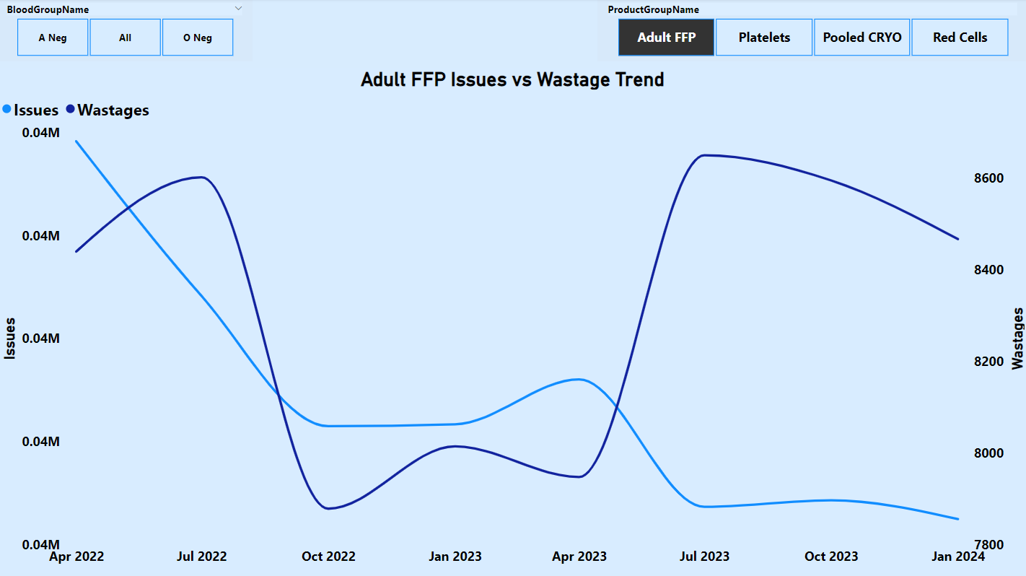
Key Insights
Adult FFP wastage surged in Q2 2023, while issues displayed a downtrend throughout the quarters.

Slide 9
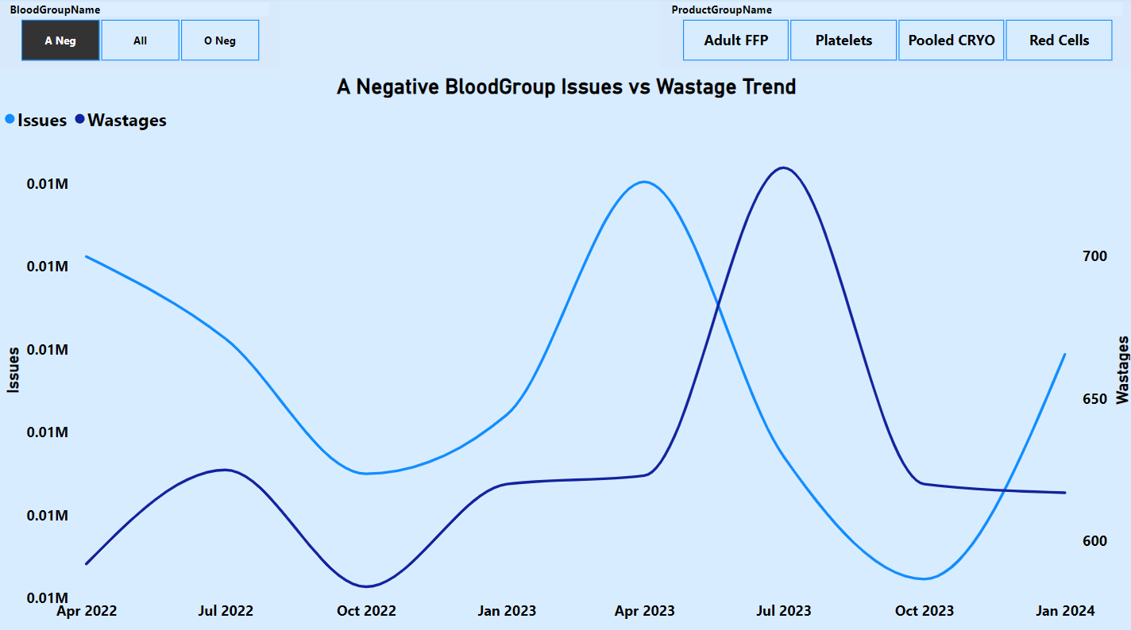
Key Insights
A Negative Blood Group Issues peaked in Q1 2023 and declined through Q2 and Q3, while wastage surged in Q2 before declining in Q3.

Slide 10
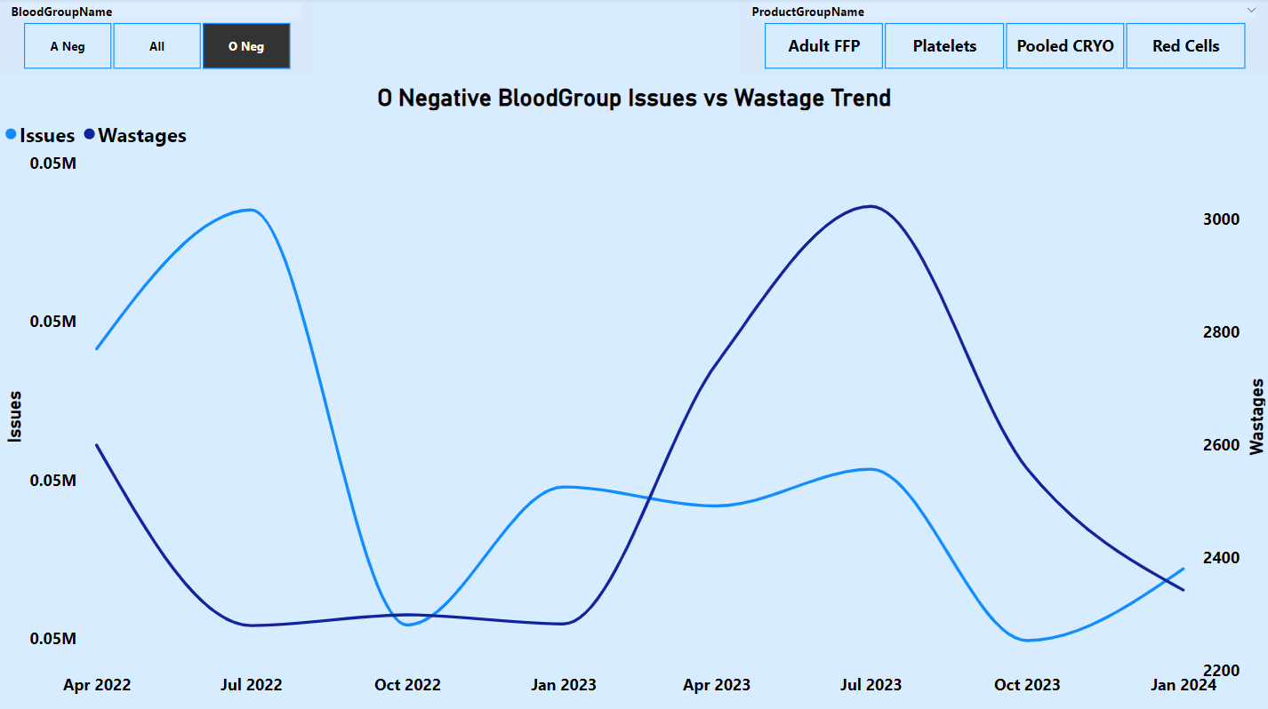
Key Insights
O Negative Blood Group Issues declined in Q3 2022, while wastage peaked in Q1–Q2 2023 before declining in Q3.

Slide 11
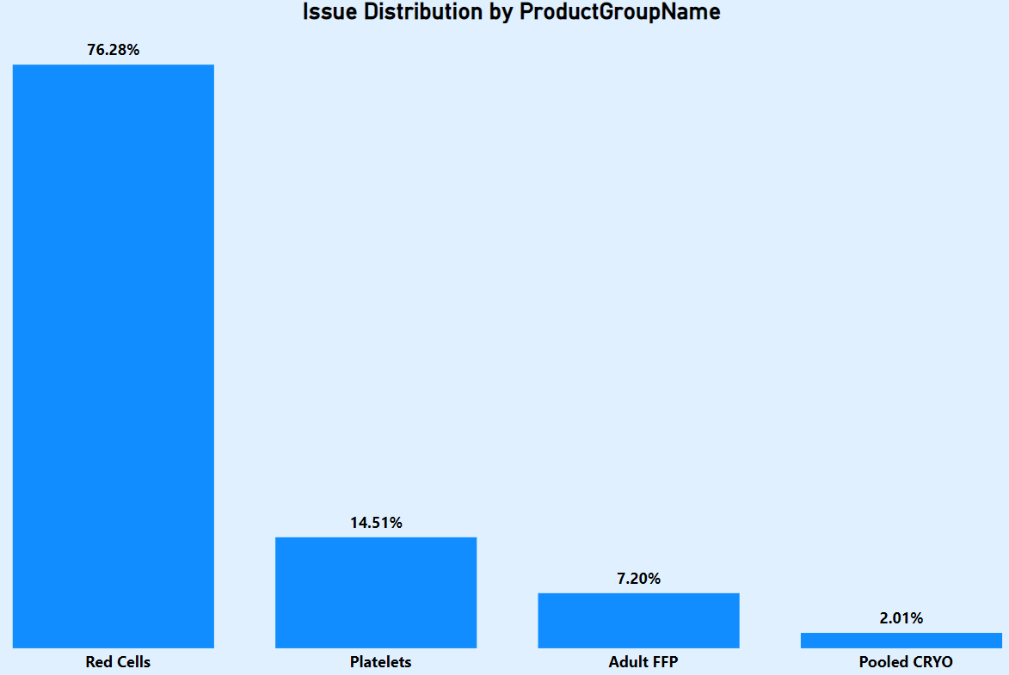
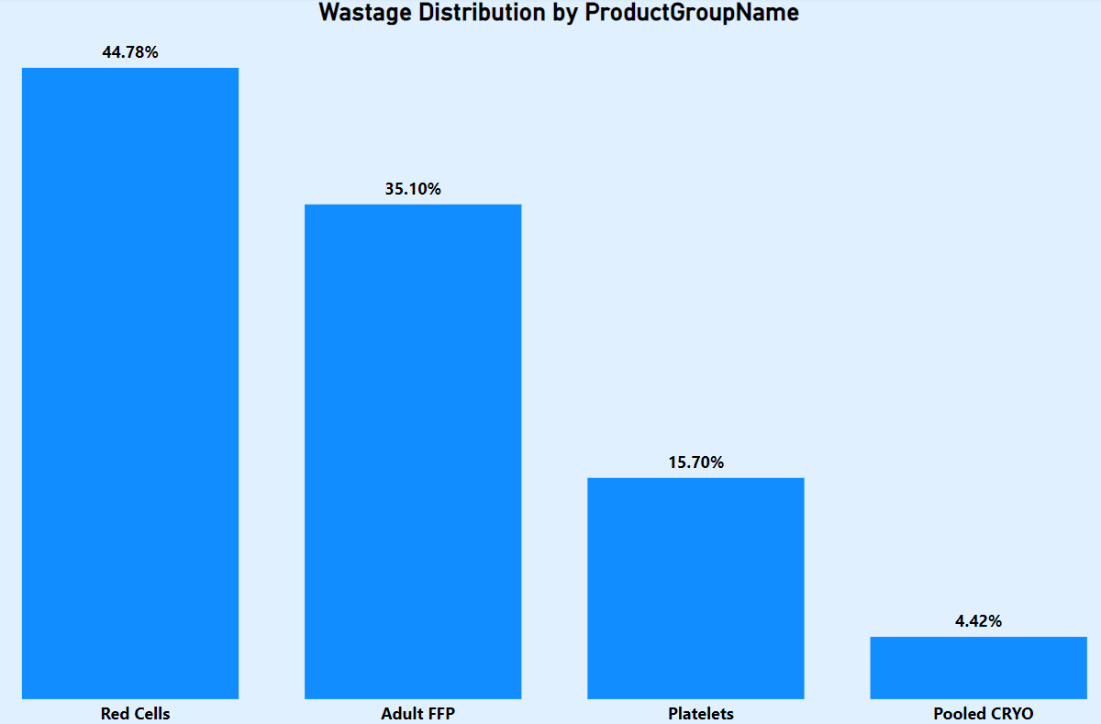
Key Insights
Red Cells have the highest units in both Issues (76.28%) and Wastage (44.78%)
Platelets and Adult FFP follow in respective distributions, with Platelets having more Issues and Adult FFP having more Wastage.

Slide 12
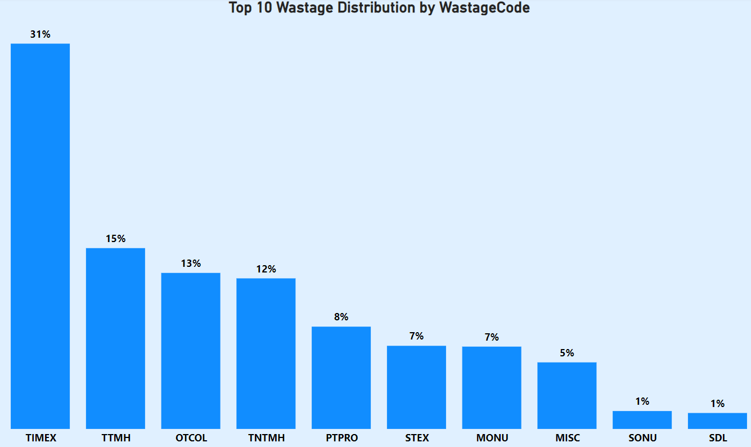
Key Insights
Root Cause of Wastage: Time Expiry (TIMEX) is the leading cause, accounting for 31% of wastage units, followed by TTMH at 15%.

Slide 13
Conclusion
Summary:
Analysis reveals critical trends in component issues and wastage.
Recommendations (Check Appendix Slides) aim to enhance inventory efficiency, reduce wastage, and improve overall supply chain performance.
A data-driven approach will enable BSMS to optimize resources and achieve its core purpose: saving and improving lives.

Slide 14

Thank you for listening.
Any Questions?

Slide 15

Appendix

Slide 16
Methodology
Business Understanding: Defined project objectives to analyze trends in hospital component issues and wastage.
Data Understanding: Explored the dataset to identify key features and relationships for analysis.
ETL Process: Extracted, transformed, and loaded the data into Power BI for compatibility and analysis.
Data Modeling: Created relationships between fact and dimension tables for structured analysis.
Analysis & Visualization: Used Power BI to generate trendline charts and visualizations, uncovering correlations and patterns in issues and wastage.

Slide 17
Recommendations
Target Top Wastage Causes: Focus on minimizing the top 10 wastage drivers, especially Time Expiry (TIMEX), which contributes the most to wastage.
Optimize RBC Management: Monitor and manage Red Blood Cell (RBC) stocks carefully due to their consistently high issues and wastage volumes.
Adjust for Seasonal Trends: Align inventory strategies with seasonal and quarterly trends to prevent overstocking during low-demand periods and shortages during peak wastage times (e.g., Q2–Q3 2023).
Blood Group-Specific Allocation: Tailor inventory levels for key blood groups like O Negative and A Negative to address fluctuations in issues and wastage effectively.
Enhanced Monitoring of Platelets and Frozen Components: Closely track and address rising wastage trends in Platelets and Adult FFP, particularly the surges observed in Q1–Q3 2023.

